Slide 1
Introduction to web technologies
HTML + CSS + Javascript
Report By-
Nayan Khairnar
Pranali Jahagirdar

Slide 2
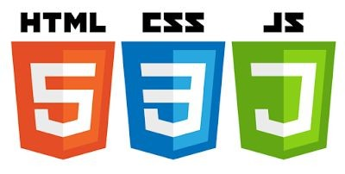
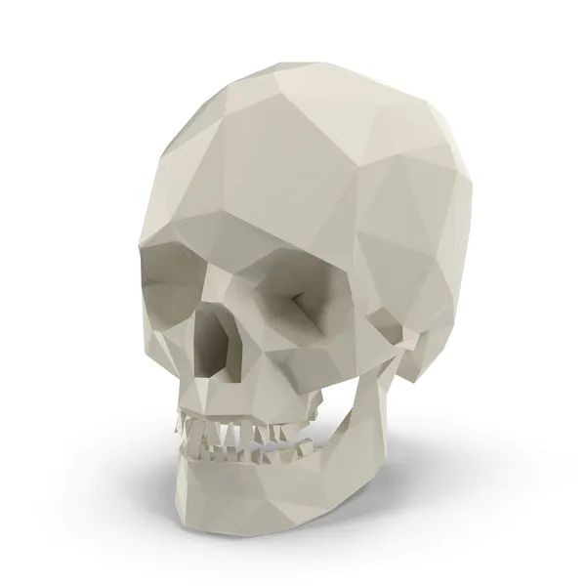

Goals
Introduction to web technologies:
HTML to create the document structure and content
CSS to control is visual aspect
Javascript for interactivity

Slide 3
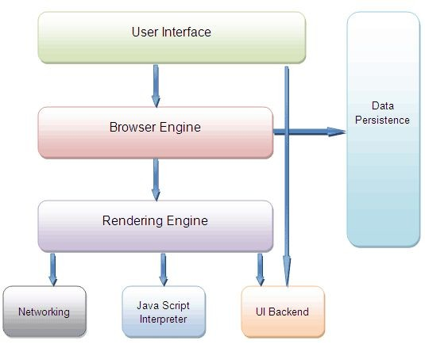
Inside a browser
Browsers have very differentiate parts.
We are interested in two of them:
the Rendering Engine (in charge of transforming our HTML+CSS in a visual image).
The Javascript Interpreter (also known as VM), in charge of executing the Javascript code.

Slide 4
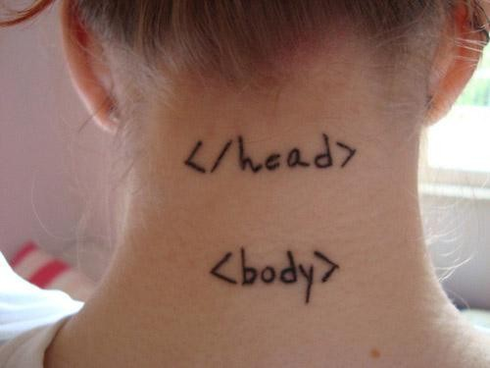
Technologies
HTML
CSS
Javascript

Slide 5
HTML
HTML means Hyper Text Markup Language.
<html>
<head>
</head>
<body>
<div>
<p>Hi</p>
</div>
</body>
</html>
The HTML allow us to construct the visible part of a website.
HTML is NOT a programming language, it’s a markup language, which means its purpose is to give structure to the content of the website.
It is a series of nested tags (it is a subset of XML) that contain all the website information (like texts, images and videos). Here is an example of tags:
<title>This is a title</title>
The HTML defines the page structure. A website can have several HTMLs to different pages.

Slide 6
HTML: basic rules
Some rules about HTML:
It uses XML syntax (tags with attributes, can contain other tags).
<tag_name> content </tag_name>
It stores all the information that must be shown to the user.
There are different HTML elements for different types of information and behaviour.
The information is stored in a tree-like structure (nodes that contain nodes inside) called DOM (Document Object Model).
It gives the document some semantic structure (pe. this is a title, this is a section, this is a form) which is helpful for computers to understand websites content.
It must not contain information related to how it should be displayed (that information belongs to the CSS), so no color information, font size, position, etc.

Slide 7
HTML: syntax example
<div id="main">
<!-- this is a comment --> This is text without a tag.
<button class="mini">press me</button>
<img src="me.png" />
</div>

Slide 8
HTML: syntax example
Tag name
attributes
<div id="main">
<!-- this is a comment --> This is text without a tag.
comment
text tag
<button class="mini">press me</button>
<img src="me.png" />
</div>
self-closing tag

Slide 9
HTML: main tags
Although there are lots of tags in the HTML specification, 99% of the webs use a subset of HTML tags with less that 10 tags, the most important are:
<div>: a container, usually represents a rectangular area with information inside.
<img/>: an image
<a>: a clickable link to go to another URL
<p>: a text paragraph
<h1>: a title (h2,h3,h4 are titles of less importance)
<input>: a widget to let the user introduce information
<style>: to insert CSS rules
<script>: to execute Javascript
<span>: a null tag (doesn't do anything)

Slide 10
HTML: other interesting tags
There are some tags that could be useful sometimes:
<button>: to create a button
<audio>: for playing audio
<video>: to play video
<canvas>: to draw graphics from javascript
<iframe>: to put another website inside ours

Slide 11
HTML: wrapping the info
We use HTML tags to wrap different information on our site.
The more structure has the information, the easier will be to access it and present it.
We can change the way the information is represented on the screen depending on the tags where it is contained, so we shouldn't be worried about using too many tags.

Slide 12
HTML: tagging correctly
Try to avoid doing this:
<div> Title
Here is some content Here is more content
</div>
Do this instead
<div>
<h1>Title</h1>
<p>Here is content. </p>
<p>Here is more content</p>
</div>
DONT DO THIS

Slide 13
HTML good use
It is good to have all the information properly wrapped in tags that give it some semantics.
We also can extend the code semantics by adding extra attributes to the tags:
id: tells a unique identifier for this tag
class: tells a generic identifier for this tag
<div id="profile-picture" class="mini-image">...</div>

Slide 14
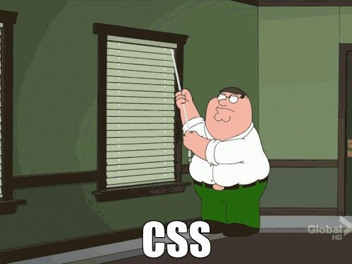
Technologies
HTML
CSS
Javascript

Slide 15
Allows to specify how to present (render) the document info stored in the HTML.
CSS
Allows to controls all the aspects of the visualization and some other features:
Colors: content, background, borders
Margins: interior margin, exterior margin
Position: where to put it
Sizes: width, height
Behaviour: changes on mouse over

Slide 16
CSS example
* {
color: blue; /*a comment */ margin: 10px;
font: 14px Tahoma;
}
This will change all the tags in my web ( ‘*‘ means all) to look blue with font Tahoma with 14px, and leaving a margin of 10px around.

Slide 17
CSS fields
Here is a list of the most common CSS fields and an example:
color: #FF0000; red; rgba(255,00,100,1.0); //different ways to specify colors
background-color: red;
background-image: url('file.png');
font: 18px 'Tahoma';
border: 2px solid black;
border-top: 2px solid red;
border-radius: 2px; //to remove corners and make them more round
margin: 10px; //distance from the border to the outer elements
padding: 2px; //distance from the border to the inner elements
width: 100%; 300px; 1.3em; //many different ways to specify distances
height: 200px;
text-align: center;
box-shadow: 3px 3px 5px black;
cursor: pointer;
display: inline-block;
overflow: hidden;

Slide 18
CSS how to add it
There are three ways to add CSS rules to your website:
Inserting the code inside a style tag
<style>
p { color: blue }
</style>
Referencing an external CSS file
<link href="style.css" rel="stylesheet" />
Using the attribute style on a tag
<p style="color: blue; margin: 10px">

Slide 19
CSS selectors
What if we want to change one specific tag (not all the tags of the same type).
We can specify more precise selectors besides the name of the tag. For instance, by class or id:
p.intro {
color: red;
}
This will affect only the tag <p class="intro">

Slide 20
CSS Selectors
The main selectors are:
tag name: just the name of the tag
p { ... } //affects to all <p> tags
dot (.): affects to tags with that class
p.highlight { ... } //affects all <p> tags with class="highlight"
sharp character (#): specifies tags with that id.
p#intro { ... } //affects to the <p> tag with the id="intro"
two dots (:): behaviour states (mouse on top)
p:hover { ... } //affects to <p> tags with the mouse over
brackets ([attr='value']): tags with the attribute attr with the value 'value'
input[type="text"] {...} // affects to the input tags of the type text

Slide 21
CSS Selectors
You can also specify tags by its context, for example: tags that are inside of tags matching a selector. Just separate the selectors by an space:
div#main p.intro { ... }
This will affect to the p tags of class intro that are inside the tag div of id main
<div id="main">
<p class="intro">....</p>
</div>
← Affects this one
<p class="intro">....</p> ← but not this one

Slide 22
CSS Selectors
And you can combine selectors to narrow it down more.
div#main.intro:hover { ... }
will apply the CSS to the any tag div with id main and class intro if the mouse is over.

Slide 23
CSS Selectors
If you want to select only elements that are direct child of one element (not that have an ancestor with that rule), use the > character:
ul.menu > li { ... }
Finally, if you want to use the same CSS actions to several selectors, you can use the comma , character:
div, p { … } ← this will apply to all divs and p tags

Slide 24
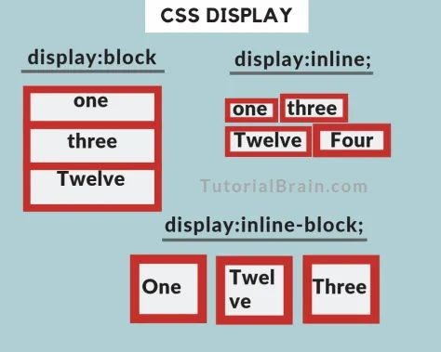
HTML arrange
It is important to understand how the browser arranges the elements on the screen.
Check this tutorial where it explains the different ways an element can be arranged on the screen.
You can change the way elements are arranged using the display property:
div { display: inline-block; }
Also check the property float.

Slide 25
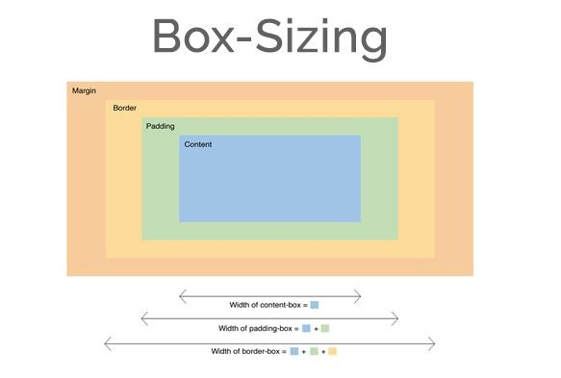
Box Model
It is important to note that by default any width and height specified to an element will not take into account its margin, so a div with width 100px and margin 10px will measure 120px on the screen, not 100px.
This could be a problem breaking your layout.
You can change this behaviour changing the box model of the element so the width uses the outmost border:
div { box-sizing: border; }

Slide 26
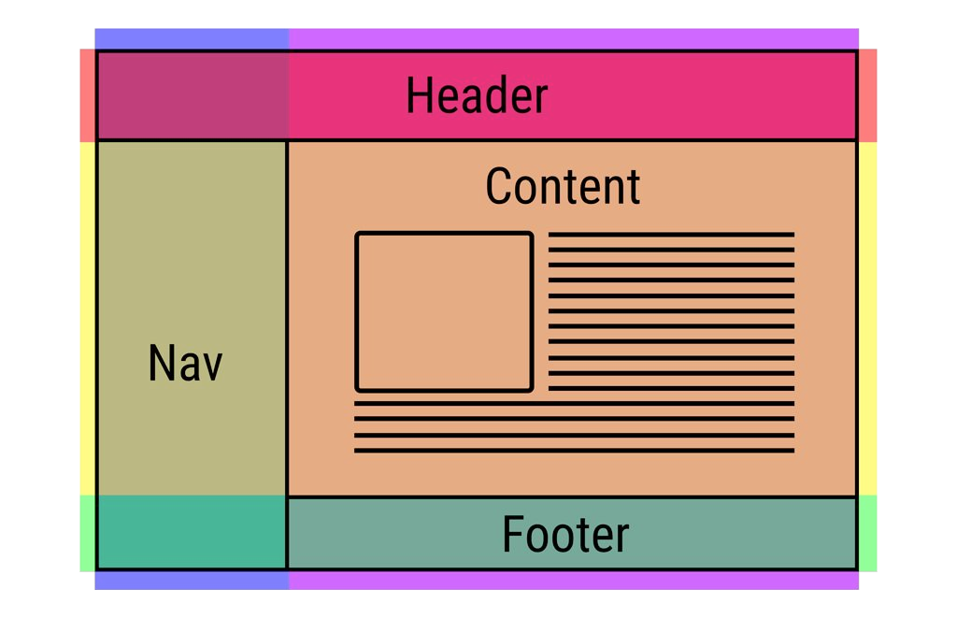
Layout
One of the hardest parts of CSS is construing the layout of your website (the structure inside the window) .
By default HTML tends to put everything in one column, which is not ideal.
There has been many proposals in CSS to address this issue (tables, fixed divs, flex, grid, …).

Slide 27
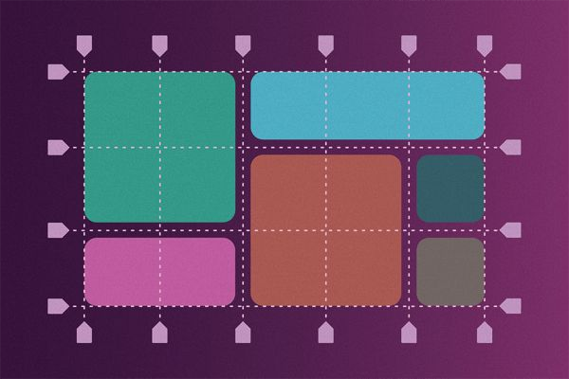
Grid system
HTML
<div class="grid-container">
<div class="grid-item1">1</div>
<div class="grid-item2">2</div>
</div>
CSS
.grid-container { display: grid;
grid-template-rows: 100px; 100px;
grid-template-columns: 100px; 100px; 100px; grid-gap: 5px;
}
.grid-item1 { background: blue;
border: black 5px solid; grid-column-start: 1;
grid-column-end: 5;
grid-row-start: 1;
grid-row-end: 3;
}
Because most sites are structured in a grid, I recommend to use the CSS Grid system.
Check this tutorial to create the site structure easily

Slide 28
Fullscreen divs
CSS
html, body {
width: 100%;
height: 100%;
}
div {
margin: 0;
padding: 0;
}
#main {
width: 100%;
height: 100%;
}
Sometimes we want to have a div that covers the whole screen (to make a webapp), instead of a scrolling website (more like regular documents).
In that case remember to use percentages to define the size of elements, but keep in mind that percentages are relative to the element's parent size, so you must set the size to the
<body> element to use 100%.

Slide 29
Trick to center
Centering divs can be hard sometimes, use this trick:
.horizontal-and-vertical-centering { display: flex;
justify-content: center; align-items: center;
}

Slide 30
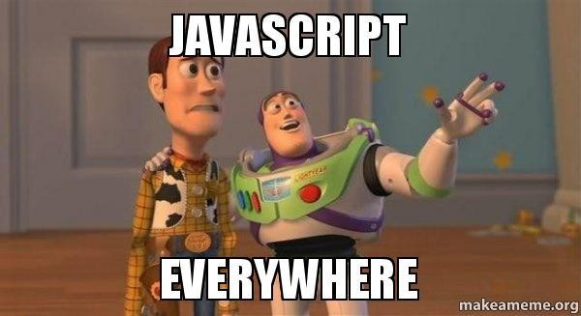
Technologies
HTML
CSS
Javascript

Slide 31
Javascript
A regular programming language, easy to start, hard to master.
Allows to give some interactivity to the elements on the web. Syntax similar to C or Java but with no types.
You can change the content of the HTML or the CSS applied to an element.
You can even send or retrieve information from the internet to update the content of the web without reloading the page.

Slide 32
Javascript: insert code
There is three ways to execute javascript code in a website:
Embed the code in the HTML using the <script> tag.
<script> /* some code */ </script>
Import a Javascript file using the <script> tag:
<script src="file.js" />
Inject the code on an event inside a tag:
<button onclick="javascript: /*code*/">press me</button>

Slide 33
Javascript: Syntax
Very similar to C++ or Java but much simpler.
var my_number = 10; //this is a comment var my_string = "hello";
var my_array = [10,20,"name",true];
var my_object = { name: "javi", city: "Barcelona" };
function say( str )
{
for(var i = 0; i < 10; ++i) console.log(" say: " + str );
}

Slide 34
Javascript example
<html>
<body>
<h1>This is a title</h1>
<script>
var title = document.querySelector("h1"); title.innerHTML = "This is another title";
</script>
</body>
</html>

Slide 35
Javascript API
Javascript comes with a rich API to do many things like:
Access the DOM (HTML nodes)
Do HTTP Requests
Play videos and sounds
Detect user actions (mouse move, key pressed)
Launch Threads
Access the GPU, get the Webcam image, ...
And the API keeps growing with every new update of the standard. Check the WEB API reference to know more

Slide 36
Javascript: retrieving element
You can get elements from the DOM (HTML tree) using different approaches.
Crawling the HTML tree (starting from the body, and traversing its children)
Using a selector (like in CSS)
Attaching events listeners (calling functions when some actions are performed)

Slide 37
Javascript: crawling the DOM
From javascript you have different variables that you can access to get information about the website:
document: the DOM information (HTML)
window: the browser window
The document variable allows to crawl the tree:
document.body.children[0] // returns the first node inside body tag

Slide 38
Javascript: using selectors
You can retrieve elements using selectors:
var nodes = document.querySelectorAll("p.intro"); will return an array with all <p class="intro"> nodes in the web. Or if we have already a node and we want to search inside:
var node = mynode.querySelectorAll("p.intro")

Slide 39
Javascript: modify nodes
From JS you can change the attributes
mynode.id = "intro"; //sets an id mynode.className = "important" ; //set class
mynode.classList.add( "good"); //to add to the current classes
Change the content
mynode.innerHTML = "<p>text to show</p>" ; //change content
Modify the style (CSS)
mynode.style.color = "red"; //change any css properties
or add the behaviour of a node
mynode.addEventListener( "click", function(e) {
//do something
});

Slide 40
Javascript: create nodes
Create elements:
var element = document.createElement("div");
And attach them to the DOM:
document.querySelector("#main").appendChild( element );
Or remove it from its parent:
var element = document.querySelector("foo"); element.parentNode.removeChild( element );
You can clone an element also easily:
var cloned = element.cloneNode(true);

Slide 41
Javascript: hide and show elements
Sometimes it may be useful to hide one element or show another.
You can change an element CSS directly by accessing its property style. To avoid being displayed on the web change display to "none"
element.style.display = "none"; //hides elements from being rendered element.style.display = ""; //displays it again

Slide 42
Using Inputs
If you want the user to be able to input some text we use the tag <input>:
<input type="text"/>
There are other inputs, you can check this list.
From Javascript we can attach events like "click" or "keydown". To read or modify the content of the input:
my_input_element.value = ""; //this will clear the text inside the input

Slide 43
Example of a website
HTML in index.html
<link href="style.css" rel="stylesheet"/>
<h1>Welcome</h1>
<p>
<button>Click me</button>
</p>
<script src=”code.js”/>
Javascript in code.js
//fetch the button from the DOM
var button = document.querySelector(“button”);
//attach and event when the user clicks it button.addEventListener(“click”, myfunction);
//create the function that will be called when the button is pressed
function myfunction()
{
//this shows a popup window alert(“button clicked!”);
}
CSS in style.css
h1 { color: #333; } button {
border: 2px solid #AAA; background-color: #555;
}

Slide 44
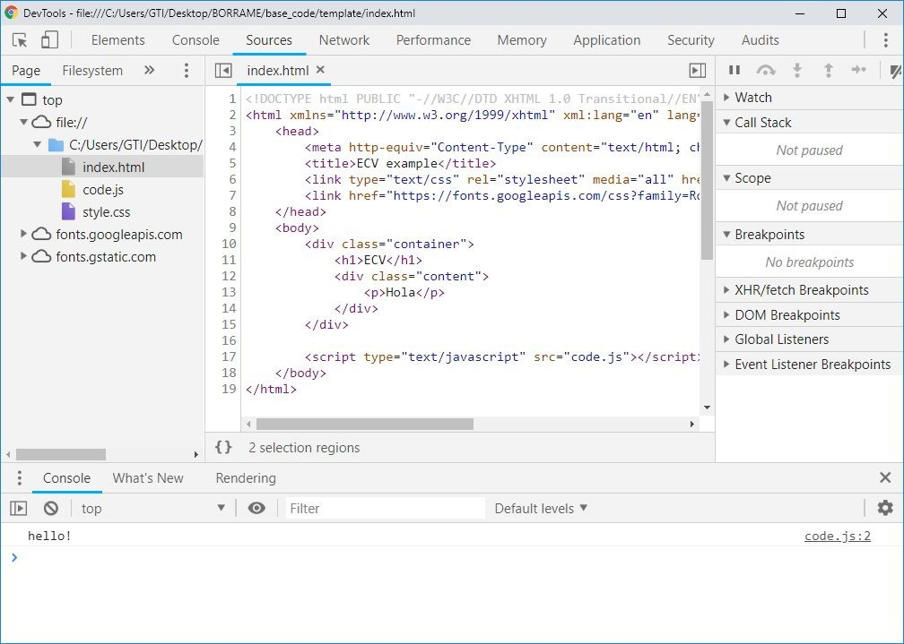
Using the Dev Tools
Press Control + Shift + I (or F12) to open DevTools

Slide 45
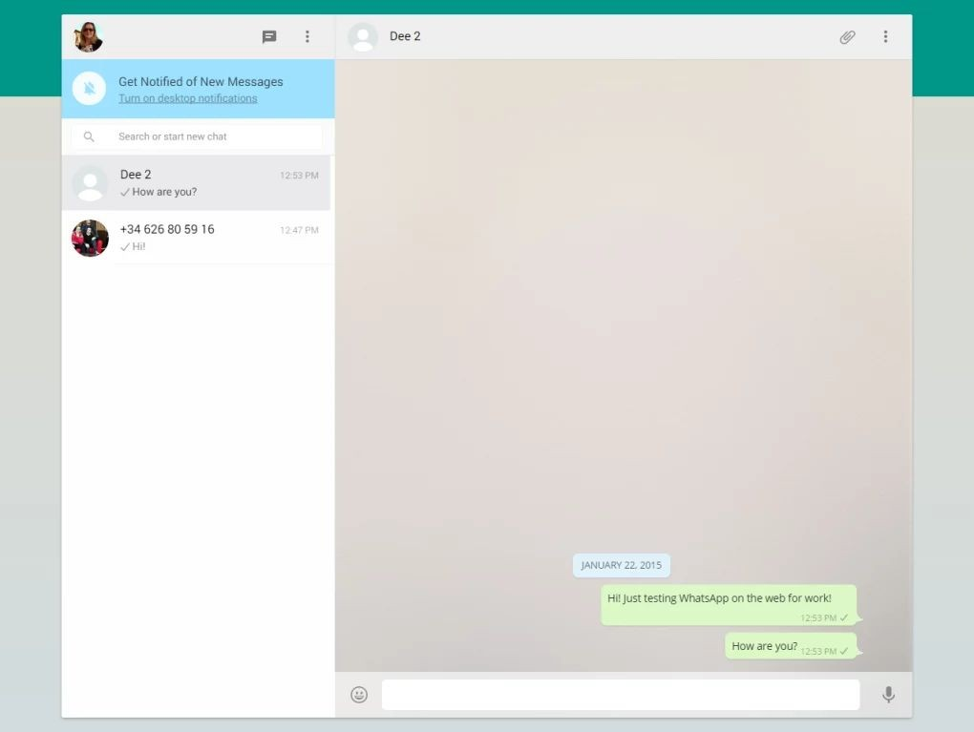
Exercise
Create the layout for a messaging application.
Structured like:
Main container
Messages area
message
Typing area area
input

Slide 46
Further info
HTML + CSS:
http://www.w3schools.com/
Selectors: https://developer.mozilla.org/en-US/docs/CSS/Getting_Started/Selectors
To learn Javascript. http://codeacademy.com To learn jQuery:
http://docs.jquery.com/Tutorials

